Slide 1
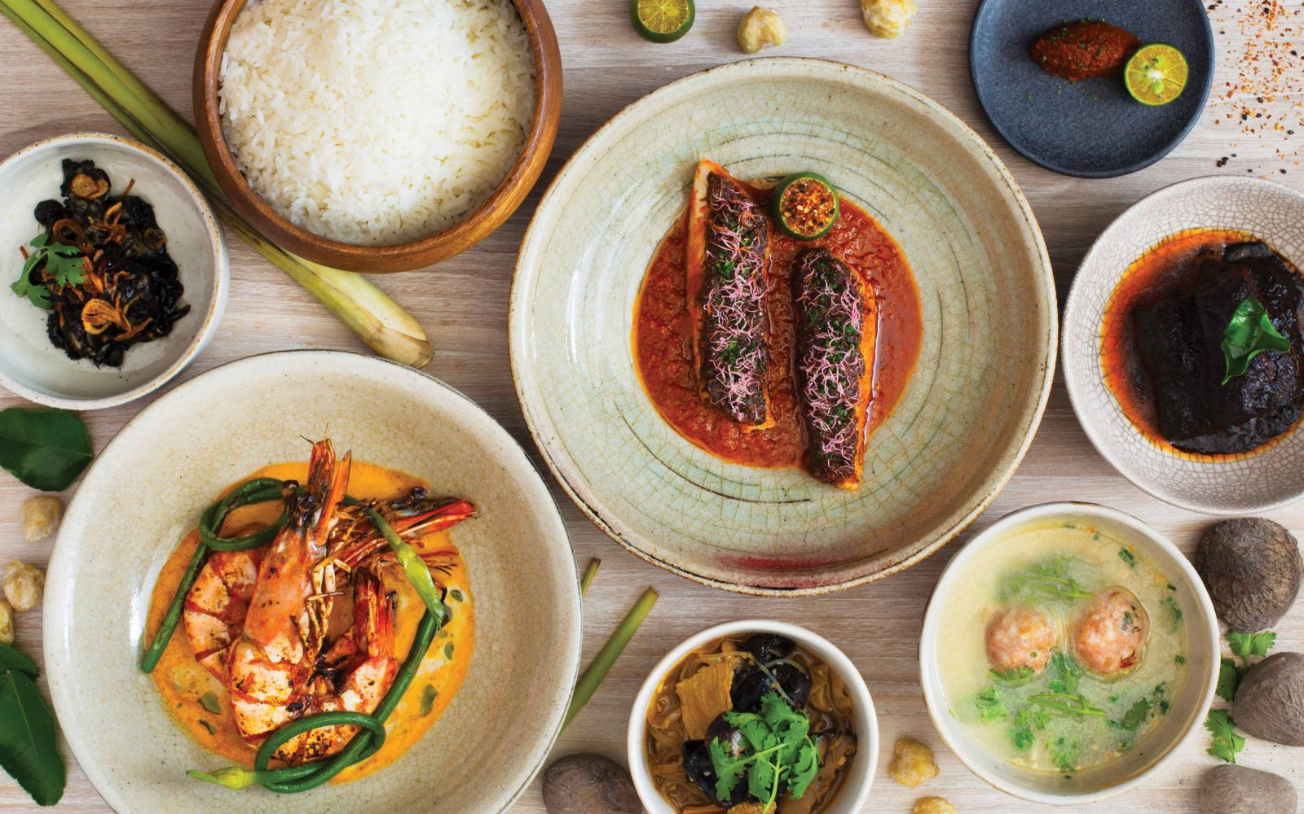
Gourment Paradise is one of 1st food ordering platform that caters to multiple cusines using fresh, healthy and nutritional ingredients to provide your great tase to your door step.
We started in 2022 in post pandemic era and has successfully setup our central kitchen and online mobile ordering platform.

Slide 2
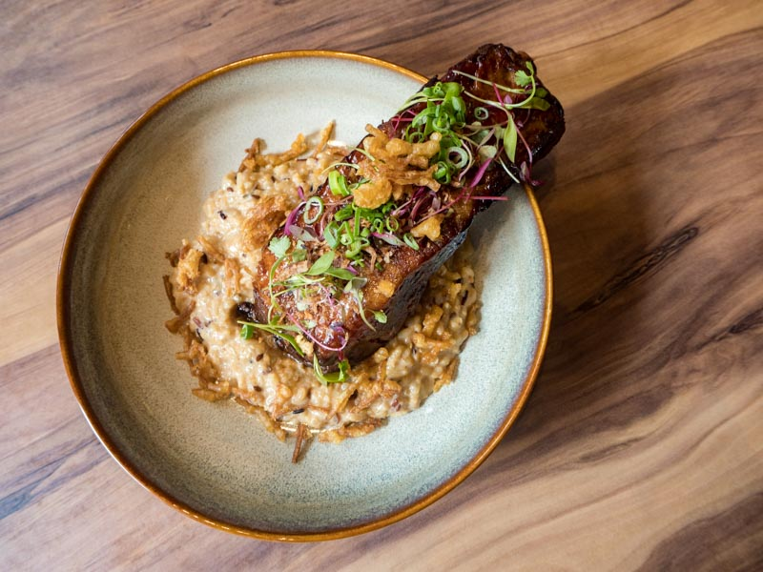



Slide 3

DELIVERY POLICY and COST
For orders below $60, a flat delivery rate of $8 will be incurred. Free delivery above $60.00.
DELIVERY SCHEDULE
We deliver on Tuesdays through Sundays, 8am – 5pm. Our drivers will inform you prior delivery via text message or phone call to let you know your orders are on the way to you next.
In the event of unforeseen circumstances such as heavy traffic jam or vehicle breakdown, our drivers will get in touch with you asap to notify of the possible delay.

Slide 4
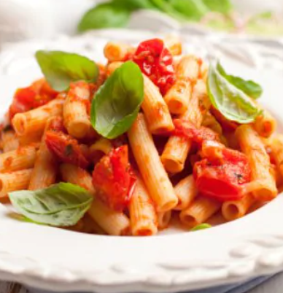
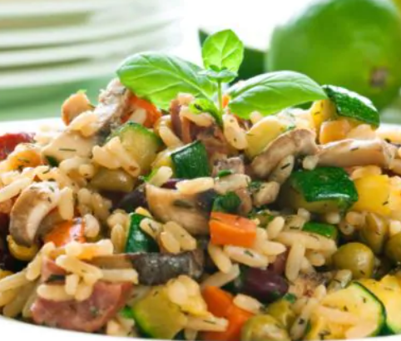
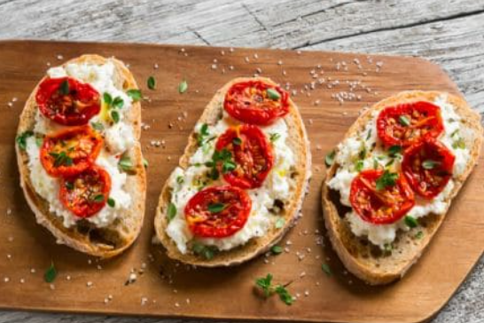

Pasta De Lasalle
Mushroom Risotto
Bruschetta
This is the most basic and simplest cooked pasta sauce, hence it is the benchmark of a good Italian home cook. This one boats of being among the original Italian recipes of pasta. easy and quick, this pasta recipe can be made under half an hour. Serve as a breakfast, pack for kid's tiffin or savour as an evening snack. You can even cook this for a casual and lazy dinner and pair this up with red wine.
A plateful of buttery risotto with the goodness of mushrooms. A healthy bowl of mushroom risotto has benefits more than you can think. A great source of protein, powerful antioxidant and even has cancer-fighting properties. This risotto recipe with mushrooms is a delicious recipe besides being easy and quick! Great to feed a hungry horde!
An antipasto dish, bruschetta has grilled bread topped with veggies, rubbed garlic and tomato mix. A country bread sliced and topped with different toppings - the evergreen tomato-basil and an inventive mushroom-garlic. The classic Italian starter!

Slide 5
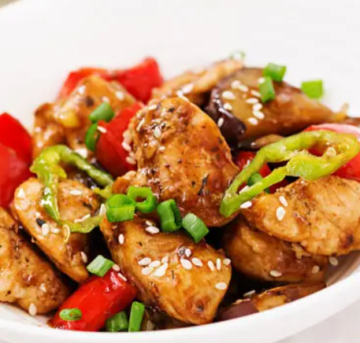
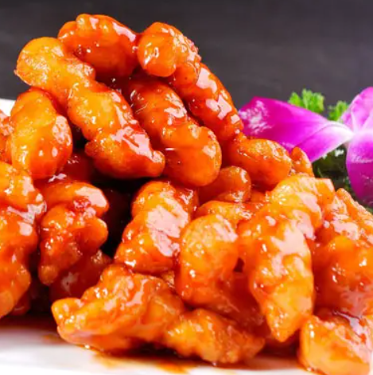
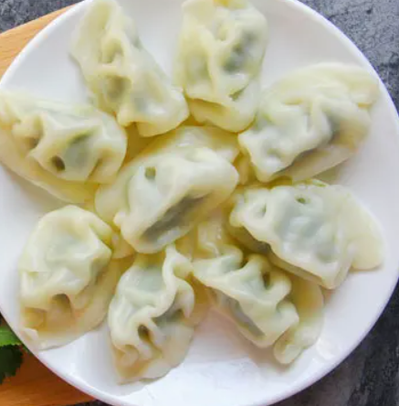
Kung Pao Chicken
Imperial Sweet and Sour Pork
Dumplings
Kung Pao Chicken (宫保鸡丁 gōngbào jīdīng) is a famous Sichuan-style specialty, popular with both Chinese and foreigners. The major ingredients are diced chicken, dried chili, cucumber, and fried peanuts (or cashews).
Sweet and sour pork (糖醋里脊 tángcù lǐjǐ) has a bright orange-red color, and a delicious sweet and sour taste. At the very beginning there was only sweet and sour pork, but to meet demands, there have been some developments on this dish. Now, the pork can be replaced with other ingredients like chicken, beef, or pork ribs.
Dumplings (饺子 jiǎozi) are a traditional food type that is widely popular, especially in North China. Chinese dumplings consist of minced meat and/or chopped vegetables wrapped in a thin dough skin. Popular fillings are minced pork, diced shrimp, ground chicken, beef, and vegetables. Dumplings can be cooked by boiling, steaming, or frying.

Slide 6
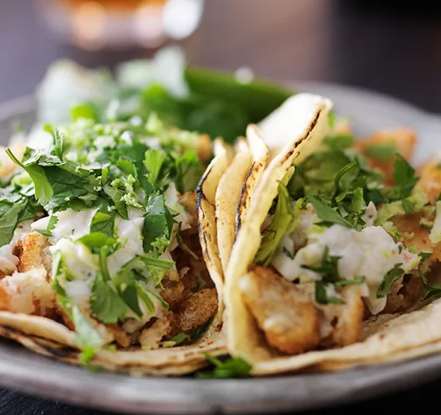
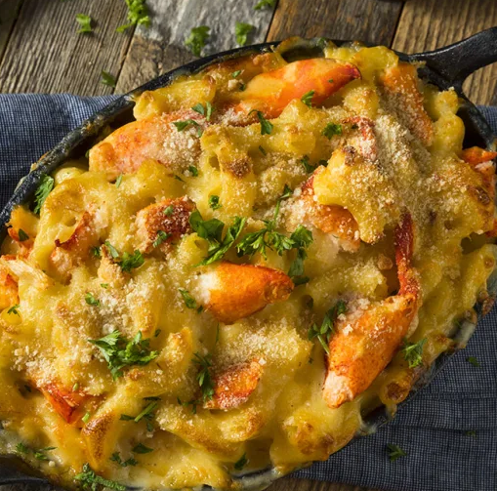
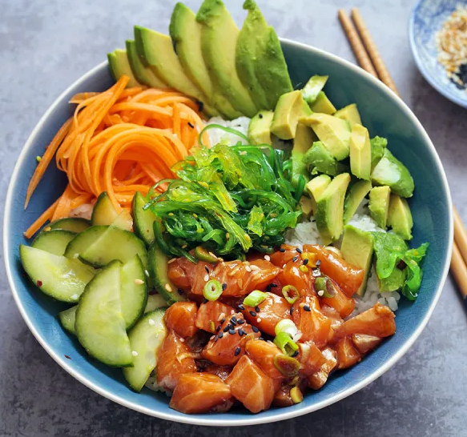
California Fish Taco
Lobster Mac and Cheese
Hawaian Poke
The classic fish taco—grilled or fried white fish (such as cod or mahi-mahi), shredded cabbage, crema, pico de gallo, and a squirt of lime all nestled into a double layer of corn tortillas—originated in Baja, California.
Nothing screams "New England" more than sweet lobster chunks, especially when they're baked into a delicious plate of mac and cheese.
And if you love this cheesy dish, don't miss these Amazing Mac-and-Cheese
Poke bowls are a common trend now, but Hawaiian people have been enjoying poke bowls for years. And with all of those delicious flavors, we don't blame them!

Slide 7
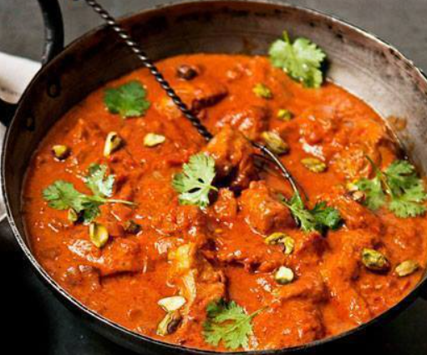
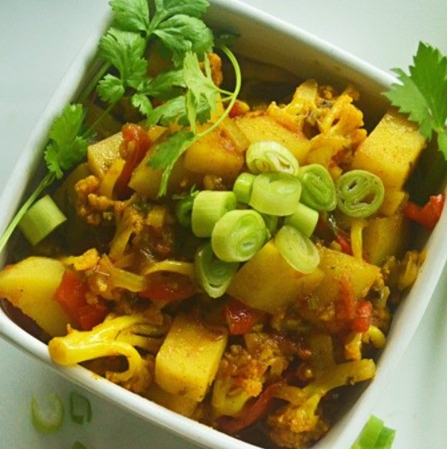
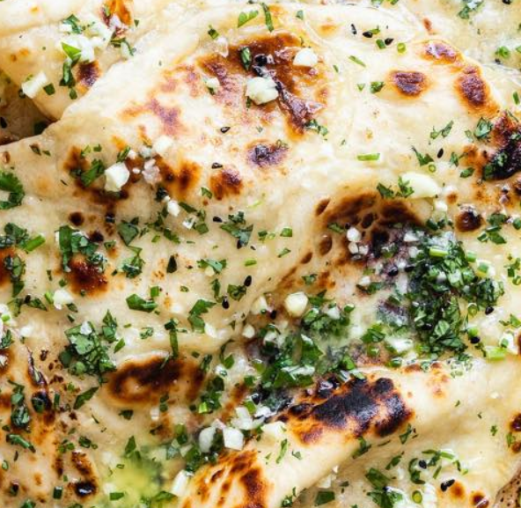
Butter Chicken
Aloo Gobi
Naan Bread
Butter chicken is mouth-watering, tender chicken, cooked in a spiced tomato sauce. It’s traditionally cooked in a tandoor (a cylindrical clay or metal oven). Order this rich authentic Indian Butter Chicken Now
Aloo Gobi is a dry, vegan Indian dish, made with potatoes (aloo), cauliflower (gobi), and Indian spices. It has a warm, yellow-orange color, because it uses a staple in Indian dishes: turmeric.
Aloo Gobi occasionally contains kalonji and curry leaves as well. Other common ingredients include garlic, ginger, onion, coriander stalks, tomato, peas, and cumin.
f you’ve never experienced good naan bread, your life has been much less delicious than it could be.
Naan is a leavened, oven-baked flatbread. You normally serve Naan with all meals.This bread is the perfect combination of chewy and crispy, buttery and garlicky. It’s exactly what every Indian dish needs to complement the otherwise bright and intense flavors.

Slide 8
Butter Chicken
Aloo Gobi
Naan Bread
Butter chicken is mouth-watering, tender chicken, cooked in a spiced tomato sauce. It’s traditionally cooked in a tandoor (a cylindrical clay or metal oven). Order this rich authentic Indian Butter Chicken Now
Aloo Gobi is a dry, vegan Indian dish, made with potatoes (aloo), cauliflower (gobi), and Indian spices. It has a warm, yellow-orange color, because it uses a staple in Indian dishes: turmeric.
Aloo Gobi occasionally contains kalonji and curry leaves as well. Other common ingredients include garlic, ginger, onion, coriander stalks, tomato, peas, and cumin.
f you’ve never experienced good naan bread, your life has been much less delicious than it could be.
Naan is a leavened, oven-baked flatbread. You normally serve Naan with all meals.This bread is the perfect combination of chewy and crispy, buttery and garlicky. It’s exactly what every Indian dish needs to complement the otherwise bright and intense flavors.

